Slide 1

Professional Environment for Cybersecurity
Translated from Spanish to English - www.onlinedoctranslator.com
Created by Álvaro González Sayago in 2º ASIR

Slide 2
Index and Structure
In this presentation we will see the following aspects of the project:
**Project carried out by Álvaro González Sayago 2º ASIR.
Alternatives | The different alternatives that you could have chosen to do this project.
Planning | Steps followed to create the project from scratch, point by point.
Software | Software used in the project, and the reason why it has been implemented.
utilities | Possible attacks that can be carried out, and their corresponding software.
Setting | Environment configuration files and what each one is for.
Keyboard shortcuts | Some shortcuts that I have configured in the environment for more comfort.
Final conclusion | Final conclusion and questions about the presentation.
For more information about the project: Review the documentation :D
Presentation made on the date of:
05/30/2023

Slide 3


Alternatives

Slide 4
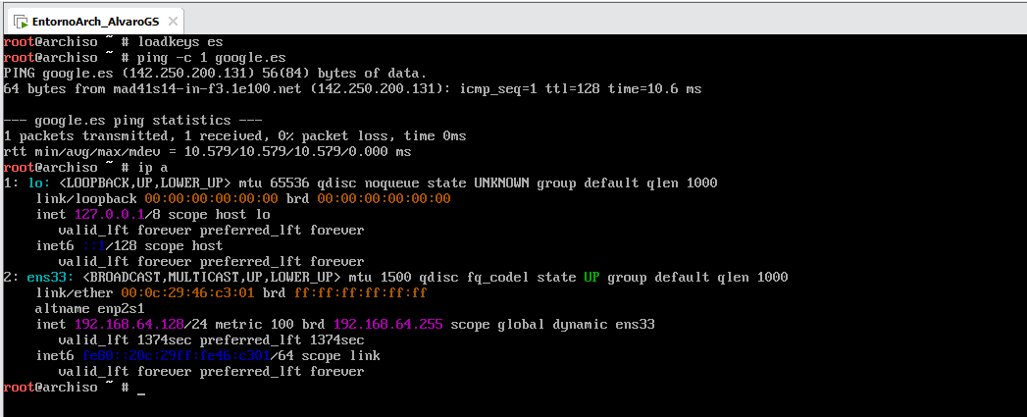
Start

Slide 5





Planning
kitty
awesomeWM
SXHKD
ARCH
PICOM
BSPWM

Slide 6
Software
Applications and packages used

Slide 7


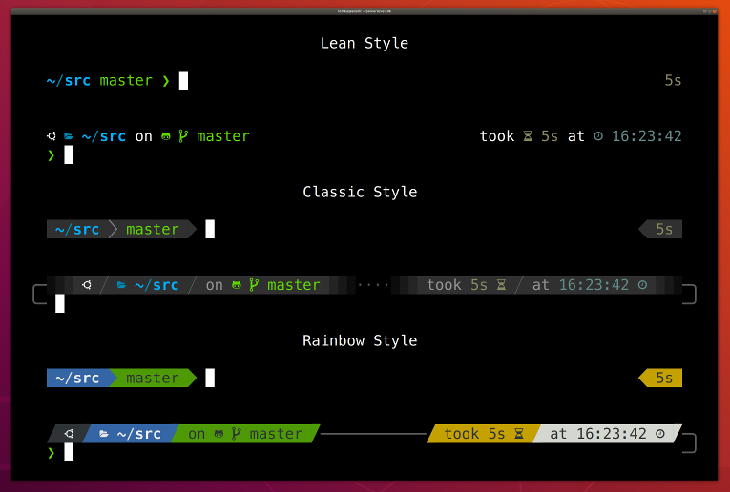
Design and Personalization
BAT
powerlevel10k
NvChad
A much more improved and powerful CAT. Used together with LSD.
Used for modifying the prompt.
Used together with NeoVIM, to modernize VIM and make it much more comfortable.
NvimTreeToggle*

Slide 8

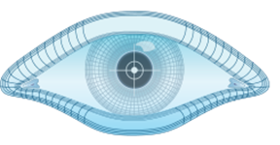

Pentesting
BurpSuite
NMAP
WFUZZ
Tool for evaluating Web applications, as well as their vulnerabilities.
Basic utility for scanning ports on computers and networks. RustScan is its modern version.
Used together with NeoVIM, to modernize VIM and make it much more comfortable.

Slide 9

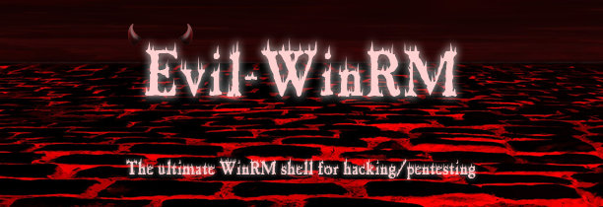

Pentesting
Evil-WinRM
metasploit
ExploitDB
Utility to take advantage of the WinRM protocol. It allows us to open a remote shell maliciously.
Framework that includesexploits,payloads, modules and toolspentesting.
Collects, organizes, and provides exploits and vulnerabilities. Creators of Searchsploit.

Slide 10
utilities
fuzzing | wfuzz, GoBuster, DirBuster, Ffuf, GoFuzz.
Phishing | SocialPhish, GoClone, UfoNet,blackeye, SETToolkit.
port scanning | Nmap, NetCat,RustScan, UnicornScan.
privilege escalation | WinPeass/linpeass,traitor,BeRoot, LES, LinuxExploit suggest.
Remote Shells | EvilWinRM, EternalTerminal, Ghost, EggShell,PentestMonkey.
SambaTools | smbmap,CrackMapExec, Smbwalk, Smbchecker.
All | PayloadsAllTheThings, Metasploit,SearchSploit, Packet.

Slide 11
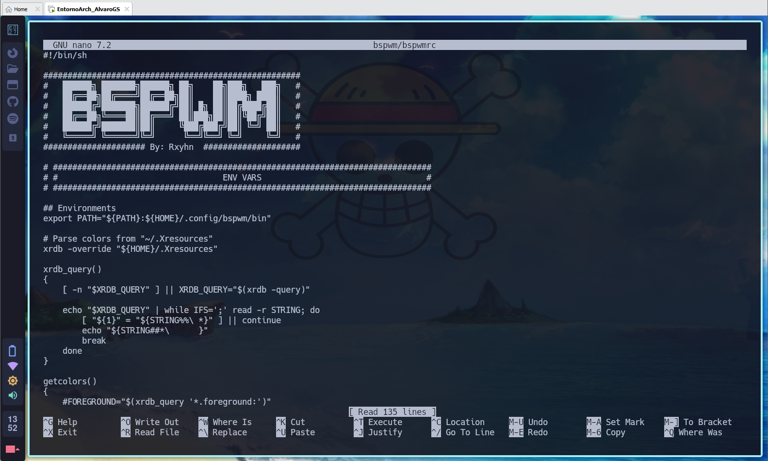
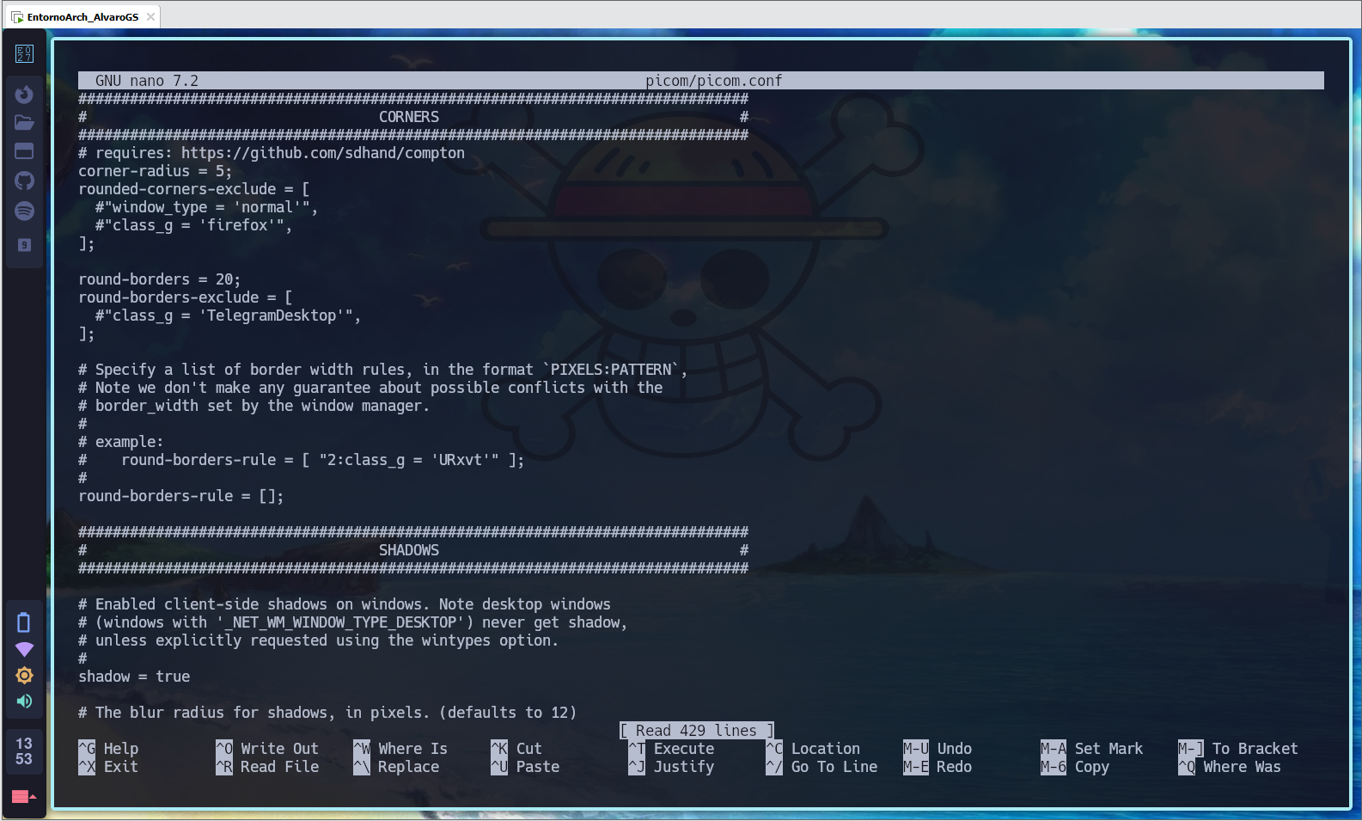
Configuration Files
BSPWMRC
PICOM
It is used to define the behavior and appearance of the environment.
transparency, opacity, animations,bordered etc

Slide 12
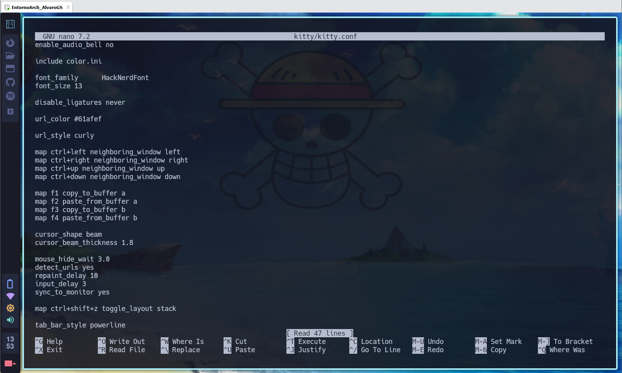
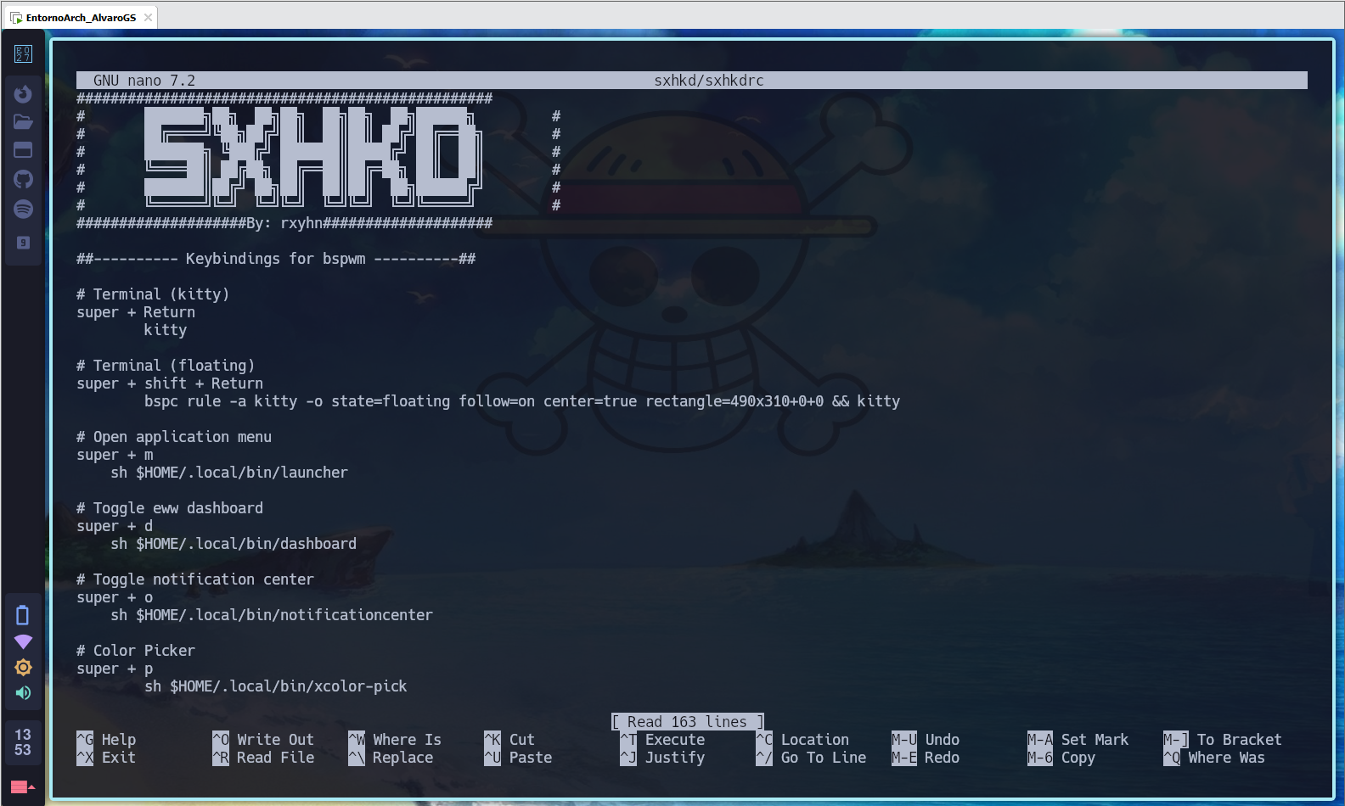
Configuration Files
KITTY.CONF
SXHKD
Modify the appearance of the terminal and functionality / key mapping.
Custom key combinations, shortcuts and commands.

Slide 13
Keyboard shortcuts
Search Command | Ctrl+R
Search Interactively | Ctrl+T
open terminal | SUPER+ENTER
Close terminal/tab | CTRL+SHIFT+W
change terminal | SUPER + ARROW + L/R
open tab | CTRL+SHIFT+T
switch tab | CTRL + SHIFT + L/R
rename tab | CTRL+SHIFT+ALT+T

Slide 14
Conclusion

Slide 15

Thanks!
Any questions?

